Slide 1
CES Ancillary Meeting
July 31, 2021

Slide 2
Welcome
&
Introductions
David Chavez
Executive
Director

Slide 3
Welcome, New and Returning Ancillary Staff!
(hired since May 15, 2021 Meeting)
Shannon Francois, OT
Judith Des Jardins, SLP
Joanne Tippeconnic, RHC
Amanda Garcia, RN
Angela Luna, LMSW
Kayla Pipkin, Diagnostician
Juliette Romero-Benavidez, Diagnostician
Daniela Villanueva, RN
Hilda Kirschner, RT
Evangeline Randall, OT
Maria Elena Corral, Bilingual SLP
Cassandra Camp, COTA
Diane Vaughn, SLP-A
Clint Montgomery, Sch PSY

Slide 4
History & Purpose of CES Ancillary Staff Meetings
History of Staff Meetings—
  CES previously held Quarterly Meetings
  CES then adjusted schedule to Twice annual Meetings
    Fall
    Spring
Purpose of Staff Meetings—
  Opportunity to impart information to Ancillary Staff as to updates and activities of Ancillary Office that impact your work in the schools.

Slide 5
Are Ancillary Staff Meetings Mandatory?
Ancillary Contract, page 2, bullet 8:
“This contract and the parties hereto are and shall continue to be subject to CES Board Policy, CES Administrative Regulations, the CES Ancillary Handbook…”
Ancillary Handbook, page 7:
“As a CES employee, Ancillary staff are expected to attend two yearly meetings. The first is in late July or early August and the second is in May.”
Ancillary meetings affirm the relationship between employer (CES) and employee (Ancillary employee).

Slide 6
Other Services Offered by CES to Member Districts
Administrative Support Services
Technical Assistance Program (TAP)
Professional and Leadership Development
Educator and Administrator Development (LEAP, TAP, SITE).
Meetings & In-services
Cooperative Procurement

Slide 7
Julie Garcia, SPHR, SHRM-SCP, ARM-P
POMS AND ASSOCIATES

Slide 8
What is new on the liability front
HB 128: SCHOOL PERSONNEL BACKGROUND & TRAINING
Title IX - Educational Amendments Act of 1972
Julie Garcia, SPHR, SHRM-SCP, ARM-P
POMS AND ASSOCIATES
July 31, 2021

Slide 9
HB 128
Written to help with the prevention of
SAMS –Sexual Abuse and Molestation of Students
Alleviate - Passing the trash – legislation required by ESEA

Slide 10

Sexual Molestation/Inappropriate Touching Claims
Note: Recent claims paid in the amount of $22.3 million not included in the graph because they predate the “10 year history” report parameters.
Note: The incurred amount for the 2019-2020 policy year is immature.

Slide 11
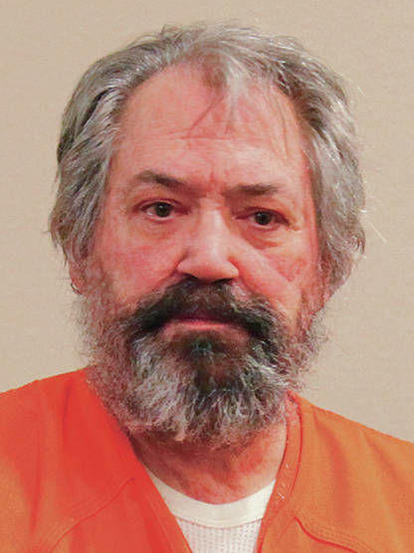
Gary Gregor - 114 years in prison after being convicted of raping and abusing girls at an Española and Santa Fe elementary schools
Behaviors first documented in 1994
Utah and Montana, accused of sexual misconduct with elementary-aged students. Termination in Utah stated he lacked professional judgment
To Santa Fe Public in 2000.
In 2004, an employee at the Museum of International Folk Art notified the district that a museum docent had seen Gregor exhibit inappropriate behavior with a student during a field trip.
Investigator corroborated accusations of inappropriate physical contact between Gregor and his female students
Gregor resigned and was given a neutral recommendation by the district.
Hired by Española Public Schools for the 2004-05 school year.
A Fairview Elementary School parent reported Gregor to the Española Police Department in April 2009, saying daughter had been sexually abused by Gregor.

Slide 12
Cost of one Predator to NMPSIA
Claims exceed $22.3 million ($3.36 million per victim average)
Still have several claims open and pending with Mr. Gregor as an active defendant.
His criminal case from his tenure at Espanola resulted in a 114 year prison sentence.
Still facing charges for his involvement while employed at Santa Fe .

Slide 13
Risk Management recommendation
Educator Misconduct
Boundaries – Step one
HB 128 – Step two
- Enforce Boundaries Policy – stop Grooming behaviors
-questions regarding past conviction or investigations
- includes licensed, non –licensed, volunteers, and contractors
-30,000 - 40,000 sets of trained eyes watching, mandatory reporters
- records of complaints and data base of investigations
- passing the trash restrictions

Slide 14
New – Definition of Ethical Misconduct
Behavior or conduct by school district personnel, school employees, school volunteers, contractors or contractors' employees:
discriminatory practice based on race, age, color, national origin, ethnicity, sex, pregnancy, sexual orientation, gender identity, mental or physical disability, marital status, religion, citizenship, domestic abuse reporting status or serious medical condition;
sexual misconduct or any sexual offense prohibited by Chapter 30, Article 6A or 9 NMSA 1978 (Sexual Exploitation of Children & Sexual Offenses) involving an adult or child, regardless of a child's enrollment status;
fondling a child or student, including touching private body parts, such as breasts, buttocks, genitals, inner thighs, groin or anus; or
any other behavior, including licentious, enticing or solicitous behavior, that is reasonably apparent to result in inappropriate sexual contact with a child or student or to induce a child or student into engaging in illegal, immoral or other prohibited behavior

Slide 15
Article 6A: Sexual Exploitation of Children, 30-6A-1 through 30-6A-4
Definitions
A. "prohibited sexual act" means:
  (1) sexual intercourse, including genital-genital, oral-genital, anal-genital or oral-anal, whether between persons of the same or opposite sex;
  (2) bestiality;
  (3) masturbation;
  (4) sadomasochistic abuse for the purpose of sexual stimulation; or
  (5) lewd and sexually explicit exhibition with a focus on the genitals or pubic area of any person for the purpose of sexual stimulation;

Slide 16
Chapter 30: Criminal Offenses Article 9: Sexual Offenses
30-9-1. Enticement of child.
Enticement of child consists of:
A. enticing, persuading or attempting to persuade a child under the age of sixteen years to enter any vehicle, building, room or secluded place with intent to commit an act which would constitute a crime under Article 9 [30-9-1 to 30-9-9 NMSA 1978] of the Criminal Code; or
B. having possession of a child under the age of sixteen years in any vehicle, building, room or secluded place with intent to commit an act which would constitute a crime under Article 9 of the Criminal Code.
Whoever commits enticement of child is guilty of a misdemeanor.

Slide 17
30-9-13. Criminal sexual contact of a minor.
A. Criminal sexual contact of a minor is the unlawful and intentional touching of or applying force to the intimate parts of a minor or the unlawful and intentional causing of a minor to touch one s intimate parts. For the purposes of this section, "intimate parts" means the primary genital area, groin, buttocks, anus or breast.
B. Criminal sexual contact of a minor in the second degree consists of all criminal sexual contact of the unclothed intimate parts of a minor perpetrated:
  (1) on a child under thirteen years of age; or
  (2) on a child thirteen to eighteen years of age when:
    (a) the perpetrator is in a position of authority over the child and uses that authority to coerce the child to submit;
    (b) the perpetrator uses force or coercion that results in personal injury to the child;
    (c) the perpetrator uses force or coercion and is aided or abetted by one or more persons; or
    (d) the perpetrator is armed with a deadly weapon.

Slide 18
30-9-13. Criminal sexual contact of a minor.
C. Criminal sexual contact of a minor in the third degree consists of all criminal sexual contact of a minor perpetrated:
  (1) on a child under thirteen years of age; or
  (2) on a child thirteen to eighteen years of age when:
    (a) the perpetrator is in a position of authority over the child and uses this authority to coerce the child to submit;
    (b) the perpetrator uses force or coercion which results in personal injury to the child;
    (c) the perpetrator uses force or coercion and is aided or abetted by one or more persons; or
    (d) the perpetrator is armed with a deadly weapon.

Slide 19
30-9-13. Criminal sexual contact of a minor.
D. Criminal sexual contact of a minor in the fourth degree consists of all criminal sexual contact:
  (1) not defined in Subsection C of this section, of a child thirteen to eighteen years of age perpetrated with force or coercion; or
  (2) of a minor perpetrated on a child thirteen to eighteen years of age when the perpetrator, who is a licensed school employee, an unlicensed school employee, a school contract employee, a school health service provider or a school volunteer, and who is at least eighteen years of age and is at least four years older than the child and not the spouse of that child, learns while performing services in or for a school that the child is a student in a school.

Slide 20
New –Applications must include
A list of all positions held by an applicant that involved unsupervised access to children (with contact information). This includes as a volunteer i.e. boy scouts, youth group, sports leagues
A written statement describing whether the applicant:
        Has ever been under investigation for, or has been found to have violated a state or federal statute relating to child abuse or neglect, sexual misconduct or any sexual offense, unless the allegations were determined to be false or unsubstantiated
        Has ever been under investigation for, or found to have violated, any ethical rule or policy of the former employer that previously employed the applicant and the outcome of the investigation including a finding that the allegation was false or unsubstantiated
        Has ever had a professional license or certificate denied, suspended, surrendered, or revoked due to a finding of child abuse or ethical misconduct or while allegations of child abuse or ethical misconduct were pending or under investigation.

Slide 21
New - Waiver for release of information
A separate written authorization that authorizes disclosure of information requested and the release of related records by the applicant’s previous employers, releasing the applicant's previous employers from any liability related to the disclosure or release of records.

Slide 22
New - Questions for former employers
Has the applicant ever been under investigation for, or has been found to have violated, any state or federal statute relating to child abuse or neglect, sexual misconduct or any sexual offense, including those offenses prohibited in Chapter 30, Article 3, 3A, 4, 6, 6A, 9, 37, 37A or 52 NMSA 1978, unless the allegations were false or unsubstantiated;
Has ever been under investigation for, or found to have violated, any ethical rule or policy approved by a former employer that previously employed the applicant, unless the allegations were false or unsubstantiated; or
Has ever had a professional license or certificate denied, suspended, surrendered or revoked due to a finding of child abuse or ethical misconduct or while allegations of child abuse or ethical misconduct were pending or under investigation.

Slide 23
Training
All employees, regular volunteers, contractor, contractor’s employees.

Slide 24
Training must include
Reporting Requirements, NMSU/ NMPSIA
Minimal standards triggering reporting; NMSU/ NMPSIA
Trauma-informed instruction; NMSU
Identification of circumstances and factors that are indicators of likely abuse or inappropriate behaviors; NMSU / NMPSIA
Ethical misconduct; NMPSIA
Professional responsibilities; NMPSIA
Investigations and procedures; TBD
Relevant legal and regulatory; TBD
Definitions. NMSU/NMPSIA

Slide 25
Required Training – Good idea
    Boundaries
    Overcoming fear of reporting
    Communication with outside groups

Slide 26
Mandatory Reporting
Who & when

Slide 27
Mandatory report (existing language)
Involving a child's parents, guardian or custodian
Every person, including a licensed physician; a resident or an intern examining, attending or treating a child; a law enforcement officer; a judge presiding during a proceeding; a registered nurse; a visiting nurse; a school employee; a social worker acting in an official capacity; or a member of the clergy who has information that is not privileged as a matter of law, who knows or has a reasonable suspicion that a child is an abused or a neglected child
Report to:
  CYFD
  a local law enforcement agency;
  a tribal law enforcement or social services agency for any Indian child residing in Indian country.

Slide 28
New - Mandatory reporting
School district personnel, a school employee, a contractor or a contractor's employee who knows or has a reasonable suspicion that a child or student has been subject to ethical misconduct by school district personnel, a school employee, a school volunteer, a contractor or a contractor's employee shall report the matter immediately to:
  the Superintendent; or
  PED
The parties (Superintendent and PED) shall immediately transmit to each other by telephone the facts of the report and the name, address and telephone number of the reporter.
The parties shall transmit the same information in writing within forty-eight hours
Written report on standardized form developed by PED

Slide 29
New - Reporting - Coordination
PED shall immediately notify law enforcement
if the allegation of ethical misconduct is criminal in nature; provided that the department shall notify a tribal law enforcement or social services agency for any Indian child residing in Indian country.

Slide 30
I made a report and nothing happened! New language
After a report of suspected ethical misconduct against a student or child is made,
the office receiving the report shall notify the person making the report within five days after the report was made that the office receiving the report is investigating the matter.
Mailing a notice within five days shall constitute compliance with this subsection.

Slide 31
New - The Investigation
The recipient of a report shall ensure that immediate steps are taken to protect the health or welfare of a student or child who is the subject of a report.
A school shall take immediate steps to ensure the safety of enrolled students.

Slide 32
New - Investigation
A superintendent may appoint a designated representative to act on the superintendent's behalf.
The Superintendent or the designated representative shall investigate all allegations of ethical misconduct about any school district personnel, school employee, school volunteer, contractor or contractor's employee who resigns, is being discharged or terminated or otherwise leaves employment after an allegation has been made.
If the investigation results in a finding of ethical misconduct by a licensed school employee, the superintendent or the superintendent's designated representative shall report the identity of the licensed school employee and attendant circumstances of the ethical misconduct on a standardized form to the department and the licensed school employee within thirty days following the separation from employment or immediately if the finding of ethical misconduct is sexual misconduct with an adult or child.
The superintendent or the superintendent's designated representative shall also report allegations of sexual assault or sexual abuse involving any school district personnel, school employee, school volunteer, contractor or contractor's employee to the appropriate law enforcement agency.
No agreement between a departing school employee and the governing authority or superintendent shall diminish or eliminate the responsibility of investigating and reporting the alleged ethical misconduct to the department or, if legally mandated, to law enforcement, and any such agreement to the contrary is void.

Slide 33
Investigator?
"designated representative" means a representative chosen by a superintendent and may include the staff of a Regional Educational cooperative.
Qualified investigator – Did the employee violate a policy – i.e. boundaries
Qualified investigator – Was the employee found to have committed ethical misconduct
behavior, including licentious, enticing or solicitous behavior, that is reasonably apparent to result in inappropriate sexual contact with a child or student or to induce a child or student into engaging in illegal, immoral or other prohibited behavior
Child interview – Use only a person qualified to interview a child

Slide 34
New- PED List
The department shall maintain a list of the names of persons reported to the PED, as required by who have been convicted of a felony or misdemeanor involving moral turpitude and, who have been found to have committed ethical misconduct. The department shall update that list each month. The department shall provide that list to a governing authority upon request.
Licensed
Non- licensed

Slide 35
Passing the Trash
Language deleted from the School Personnel
Act by HB128

Slide 36
Title IX
Educational Amendments Act of 1972.
  prohibits sex discrimination in educational programs or educational activities that receive federal financial assistance.
The type of discrimination in education covered by Title IX includes
  sexual harassment,
  pregnancy discrimination,
  equal opportunity in athletics,
  sexual assault policies,
  gender expression, gender identity, and sexual orientation.

Slide 37
The 2020 changes to Title IX
Regulations on Sexual Harassment- effective August 14, 2020. Changes include:
  New terminology, policy and notice requirements
  Limitations on jurisdiction
  Optional burdens of proof;
  Revised Title IX Coordinator responsibilities
  Revised investigation procedures
  Expanded hearing rights options for K-12 hearings
  New rules for appeals
  Expanded training requirements and record keeping

Slide 38
New Definitions
“Sexual Harassment”- means conduct on the basis of sex that satisfies one or more of the following:
A school employee conditioning education benefits on participation in unwelcome sexual conduct (i.e., quid pro quo); or
Unwelcome conduct that a reasonable person would determine is so severe, pervasive, and objectively offensive that it effectively denies a person equal access to the school's education program or activity; or
Sexual assault (as defined in the Clery Act), dating violence, domestic violence, or stalking as defined in the Violence Against Women Act (VAWA).

Slide 39
NEW Definitions, cont’d
“Complainant” means an individual who is alleged to be the victim of conduct that could constitute sexual harassment. The Final Rule expressly recognizes the legal rights of parents and guardians to act on behalf of parties (including by filing formal complaints) in Title IX matters.
“Respondent” means an individual who has been reported to be the perpetrator of conduct that could constitute sexual harassment.

Slide 40
Title IX Coordinator
Required to receive all complaints of Sexual Harassment including
adult to adult,
adult to student,
student to student,
contractor to employee,
contractor to student.
Initiate investigation for all formal complaints filed by a complainant

Slide 41
Investigation -similar to EEOC Investigation
  Effort to ascertain facts related to complaint
  Witnesses
  Documents
Effort to establish history of respondent
  Can include past conduct
  Interview of past and current associates
  Past behaviors with current employer
Unclear on involvement of law enforcement

Slide 42
Good News
The regulations are under review by the current US Secretary of Education.
There will be changes
Will probably Not affect all rules on Sexual Harassment under Title IX
-still cover unwelcome conduct
-still cover Quid Pro Quo
-still cover most, if not all, action in an educational environment
Neither new or old rules affect Title VII of the Civil Rights Act of 1963
covers unwelcome conduct/ hostile environment
covers Quid Pro Quo
May have an effect in NM under the new Civil Rights Act
Up to 2 million in awards
Like Title VII can only be filed against employer
Potentially cover SAMS violations and other sexual misconduct

Slide 43
Questions
Julie Garcia ARM-P, SPHR, SHRM-SCP
505 -249-6824
jgarcia@Pomsassoc.com

Slide 44
Break

Slide 45
Robin Strauser,
Deputy Executive Director
Staff Information

Slide 46
Ancillary Services to School Districts
--During 2020-2021 SY
CES Ancillary Staff serviced
112 member districts,
charters, and BIE
schools.
--Ancillary services = 10%
of CES revenue
Notes:
During

Slide 47
Staff Allocations & Pay and District Invoices:
A Balancing Act
Ancillary Handbook Define “Allocation”
  V. Conditions of Employment
    B. Schedule
      “An ancillary staff member’s allocation indicates potential earnings including amounts for mileage and per diem. This allocation is an estimate and may be subject to change throughout the contract year. This allocation may be adjusted or terminated if the institution modifies its service requirements with CES.”
2020-2021 School Year was marked by increased email traffic / communication between CES Ancillary Office, Business Office, and Districts related to questions on invoices.
Notes:
Explain PPP Loan Timeline
May 2020—PPP loan awarded to CES

Slide 48
A Few Reminders from the Business Office
Remain within your allocation
Communicate with administrator and Ancillary Office (Mimi) regarding any possible overages.
Enter your hours on time.

Slide 49
Referral Bonuses
CES offers a bonus to CES Ancillary employees if we hire someone you refer. Referral bonuses range from $100 - $500, dependent upon the number of days per week the new staff member is allocated.
If you know someone interested in working for CES let them know they can apply online at www.CES.org!
Notes:
CES Ancillary Staff are best recruitment tool we have available.

Slide 50
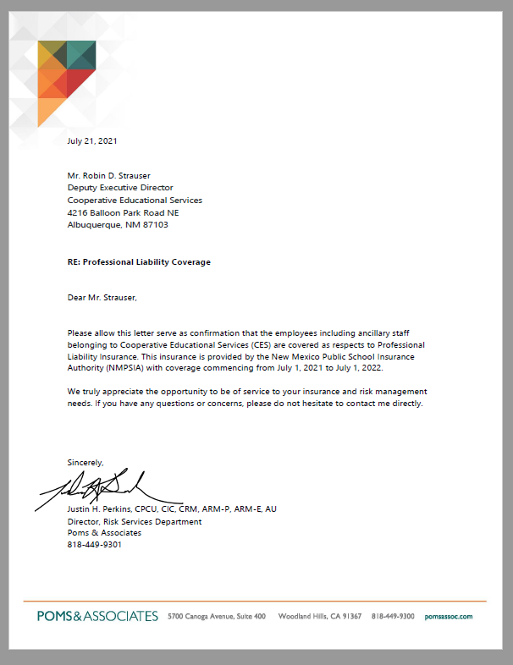
Professional Liability Insurance
POMS & Associates
Notes:
POMS & Associates is the provider of professional liability insurance

Slide 51
Natasha Orona,
Payroll Specialist
Staff Information

Slide 52
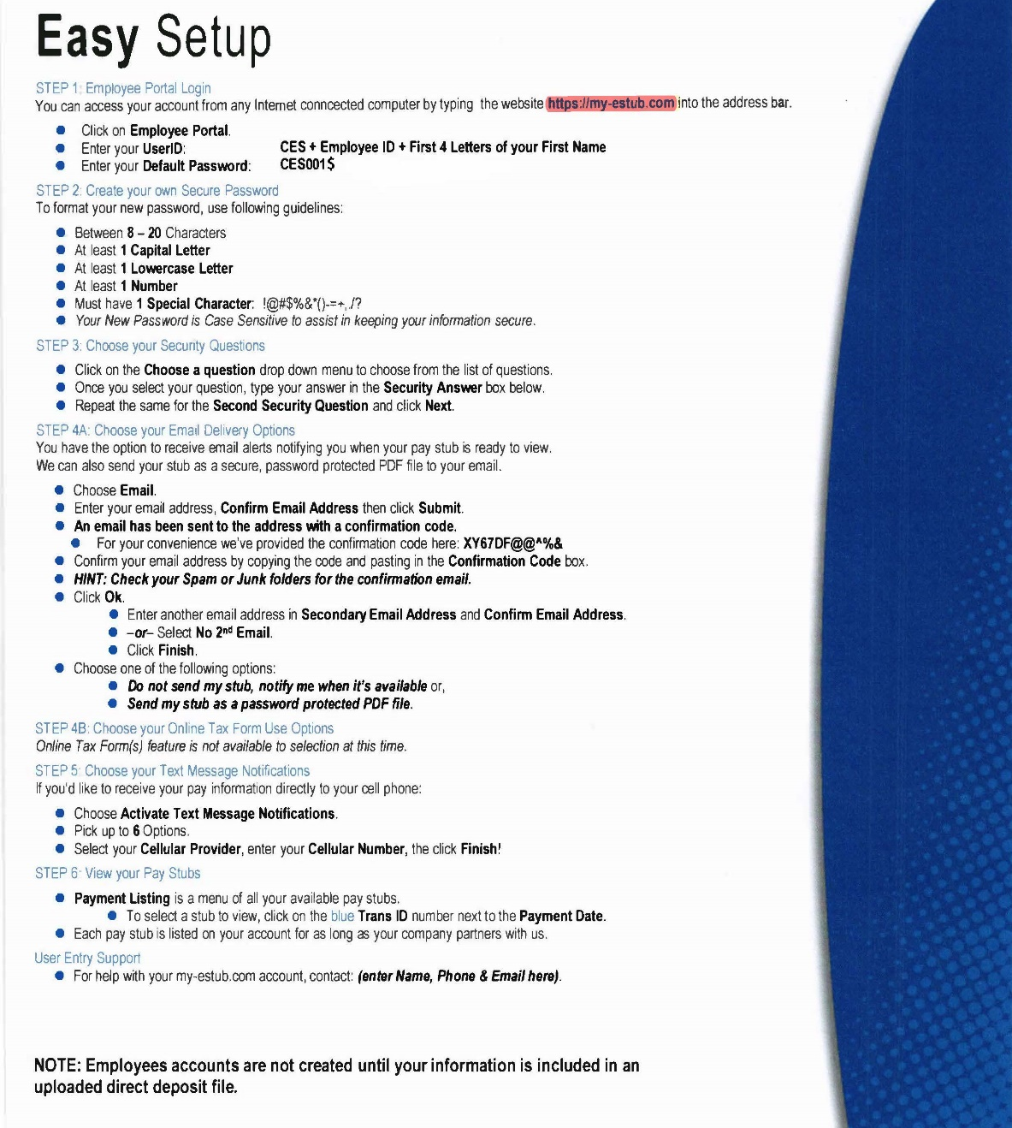
Instructions on setting up your paperless pay:
This is also in your folder.

Slide 53
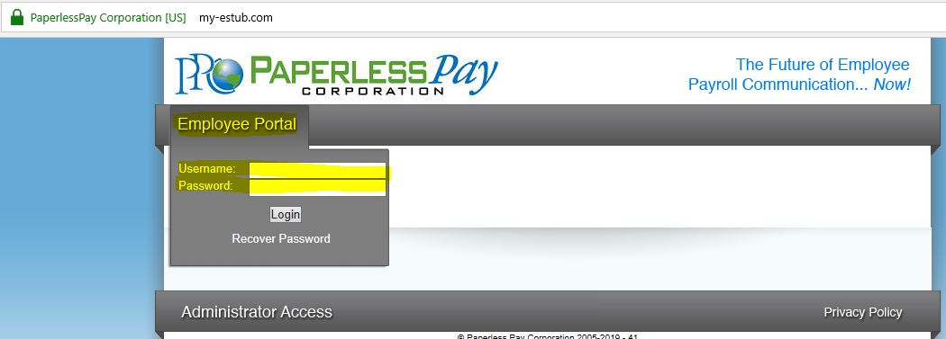
Online Pay Stubs
Instructions on how to get your online paystub will be emailed to you.
You will NOT be able to log in and create your account until your first direct deposit paycheck.
These will stay online for as long as you work for CES.
https://my-estub.com

Slide 54
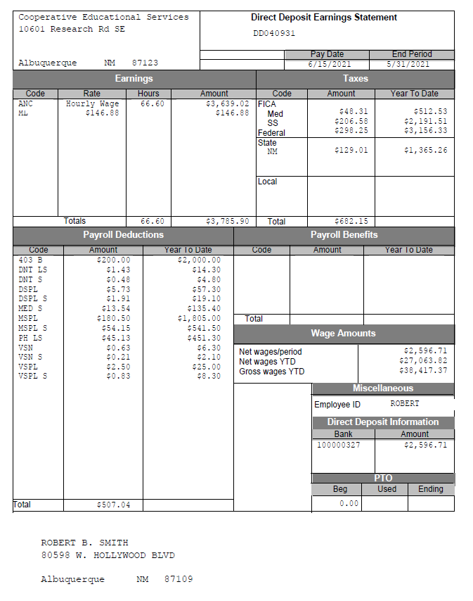
Pay Section/Codes
Taxes
Payroll deductions
Codes
Net wages

Slide 55
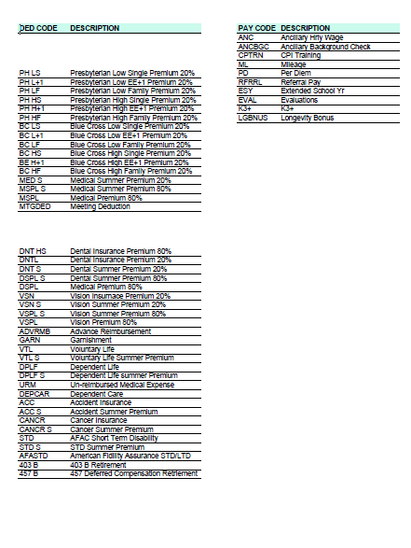
Deduction codes you may see on your paystub and what they mean:
This is also in your folder.
Notes:
Subject to updating, to be updated shortly.

Slide 56
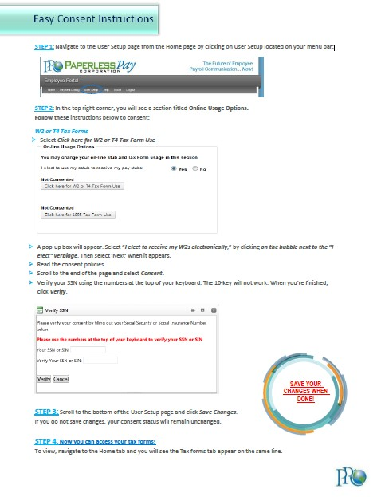

W-2 Info
Consent for electronic W-2 form:
Provide consent for electronic W-2 to be available electronically
For further information or assistance, please contact Natasha at natasha@ces.org

Slide 57
Lisa Chacon-Kedge
Director of
Ancillary Services
Ancillary General Information

Slide 58
You should have received:
Copy of CES Contract—please return contracts to Teri via Adobe Sign and return
Allocations are available in portal and copy is available for you at the registration desk if needed
School calendars—link to school calendar and start dates sent via email. Also available in hard copy if needed.
Notes:
Teri sent signed contracts to you with signatures.
Allocations are available via portal
School calendars—
If CES AO received updated school calendar and start dates for your assigned schools, we forwarded you that information via CES email.
If you did not receive it, please contact us. It is possible that
District / charter did not submit an ancillary request, contract, or respond to request for calendar. We will continue to try and get that information for you.

Slide 59
Other Ancillary Requests
Please check your CES email regularly and use CES emails for all correspondence with Ancillary Office staff. All outgoing correspondence (mass emails) will go out to your CES email.
Time due in the portal
  1st – 15th due on the 15th of the month at 11:59 PM
  16th – 31st due on the last day of the month at 11:59 PM
  Note: Late entries may potentially lead to late payment for services.
  Note: Late entries appear on subsequent invoices to districts and raise questions about fees.

Slide 60
Monitoring Your Allocation
Year to Date summary report in the Manage Reports tab on the portal can tell you how much you have left on your allocation throughout the year.
  CES Portal→Manage Reports→Year to Date Summary Report
Staff Allocation—report in the Manage Reports tab can give you information on how many hours you should be billing for on a weekly basis.
  CES Portal→Manage Reports→Year to Date Summary Report
Recommendation: Do your best to remain within weekly allotted hours. More to come on this topic.
Notes:
Mimi will be providing details and instructions on how to access these reports.
In previous years, during these trainings, we have emphasized the importance of reviewing your YTD summary. But it is equally important to know the details outlined in your allocation that indicate the hours per week that you are scheduled to work.
During the course of the school year, as we were making a number of adjustments to allocations, district administrators and business office managers offered their explanation on how they interpret and prepare their payment schedules to CES for your services.

Slide 61
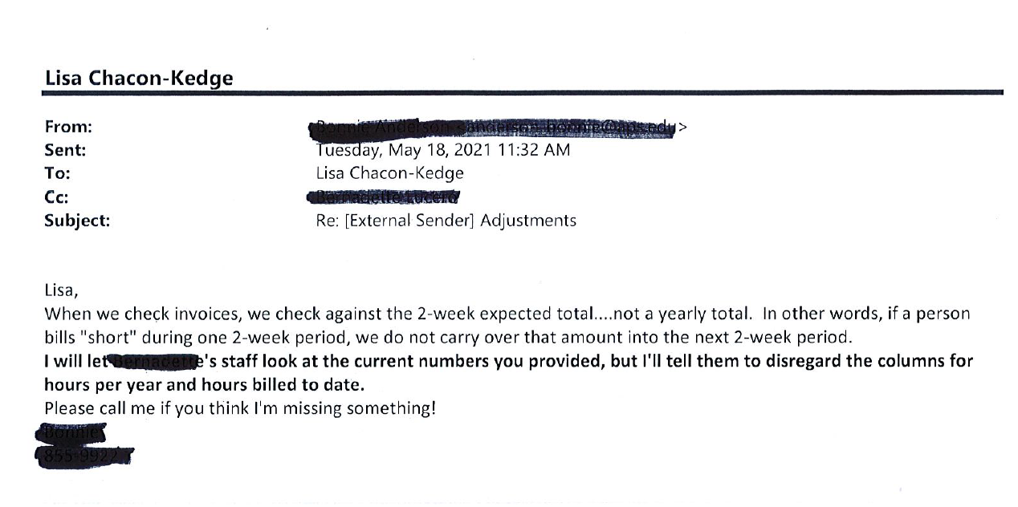
Important to Monitor both YTD and Weekly Hours
Notes:
Talking points:
So one district’s response /interpretation is outlined in this slide…
YTD summary shows balance at end of school year, please make sure your district admin approves you to work after that calendar date.
Make sure you are getting the approval of the right people in your district: those who pay the bills.

Slide 62
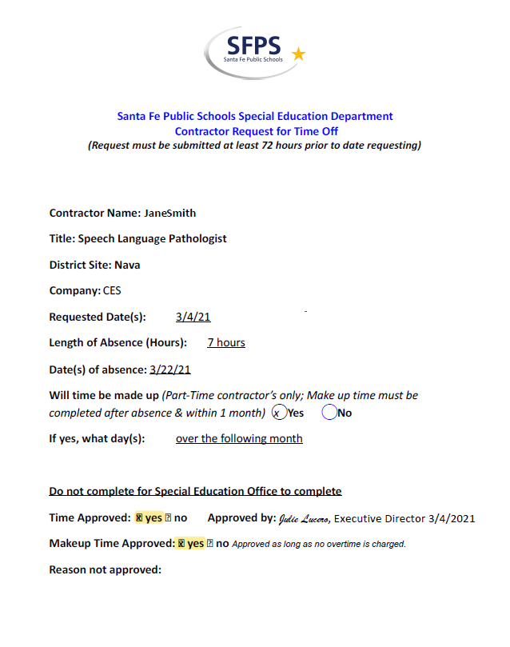
Important to Monitor both YTD and Weekly Hours
Notes:
So, while one district does not accommodate, other districts have accommodated staff by allowing them to complete a leave form detailing the date/# hours they’ll be out and the dates that they propose to make up that time.

Slide 63
Districts with Specific Professional Service Agreements
Albuquerque Public Schools
  Special invoicing requests/expectations
Espanola Public Schools
  Special invoicing requests/expectations
Santa Fe Public Schools
  Limits on travel reimbursement.
Santa Fe Public Schools Office of Student Wellness
  Limits on travel reimbursement
Hatch Valley Public Schools
  Bilingual preferred
Notes:
If you are assigned to any of these school districts, we will be meeting with you separately to go over details.
One important note for RNs in Santa Fe Public Schools or SFPS OSW:

Slide 64
The Payroll Invoicing Cycle
Example:
  12/01/2020 through 12/15/2020 Pay Period
    Staff have until 11:59 pm on 12/15/2021 to enter their time.
  12/16/2021—Auditing of timesheets
    Following CES’s established auditing instructions
    Periodic Staff Listing and Timesheet Audit reports up to 1,400 to 1,800 pages in length
    Auditing takes 3-5 days
  12/22/2021—Processing Payroll and Invoices from CES Ancillary Office to Business Office for payroll and invoices
  CES Ancillary Staff pay processed
  School Districts Invoiced for services provided during that pay period.
    Additionally, late timesheets for previous pay periods may be invoiced as well.

Slide 65
The Payroll Invoicing Cycle (Cont.)
CES Business Office automatically issues invoices to districts
CES Ancillary Office sends “back up” reports to accompany invoices at same time.
Respond to district inquiries/disputes related to charges.
  Provide additional documentation to districts
    Periodic Institution Listing
    Timesheet Audit report
  Follow up with CES Ancillary staff if available reports do not provide sufficient detail
  Make necessary adjustments
    Credits to district
    Deductions from ancillary staff

Slide 66
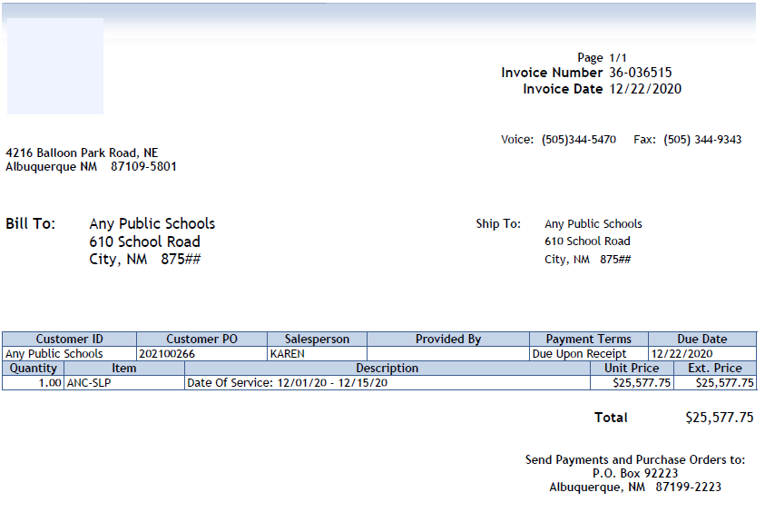
Example of Invoice
Notes:
Invoices are automatically
SLP: 7

Slide 67
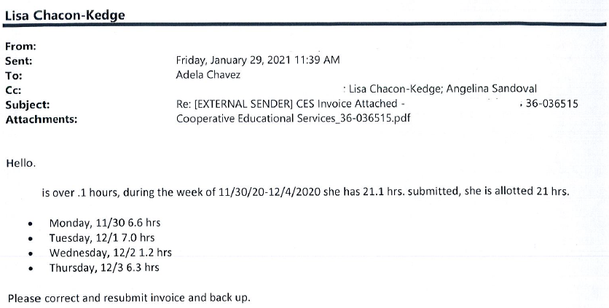
Response from District

Slide 68
Adjustment Required
Total deduction amounted to less than $10.00
Estimated time/man hours to adjust:
CES Ancillary Office staff member—1.5 hours
CES Business Office staff—1.5 -2 hours
Adjustment needed in order to receive payment of $25,000+ invoice.

Slide 69
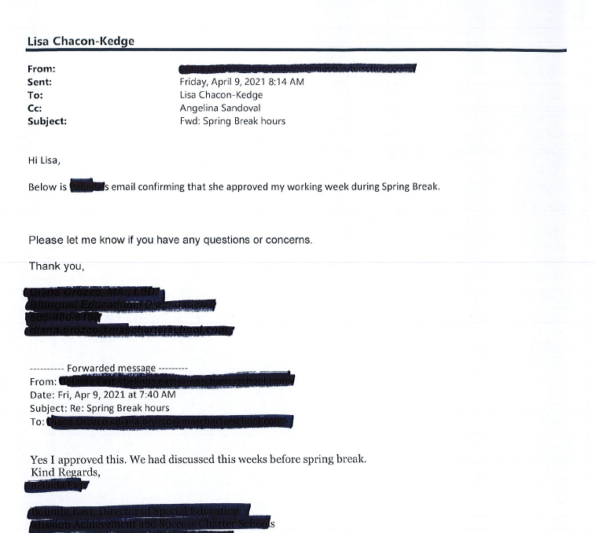
On the other hand…
Other member districts have different needs and will make different decisions regarding overages
Allowance for work during spring break 2021
  Documented in advance
  Approved in advance
  Paper trail created

Slide 70
Going Forward
CES Ancillary Office Efforts
  Enhance / Update CES Ancillary Portal
  Continue communication with staff as needed to discuss and seek approval for overages.

Slide 71
Discipline Representatives:
DIAG:
  Vacant
Nurse:
  Amanda Burns, RN
OT:
  Talia Houser, OT
RHC:
  Geraldine Gallegos – Gerrie@ces.org
RT:
  Tom House – Thouse@ces.org
PT:
  Janet Cottle – Jcottle@ces.org
Sch Psy/Psych:
  Tammy Christensen – Tchristensen@ces.org
SLP:
  Sara McGinnis – smcginnis@ces.org
SW:
  Scott Bernhardt, LCSW

Slide 72
CES
Human Resources Updates
Teri Thelemaque
Human Resources Specialist

Slide 73
Updated paperwork
Please make sure that your licenses are current.
As they expire, please make sure you send updated copies of the following to Teri:
  Board license
  PED license
  CPI/CPR certifications
  Auto insurance
Notes:
Remember: We know a thing or two because we’ve seen a thing or two. JK Simmons Farmers Insurance

Slide 74
Yearly Trainings
There are 3 mandatory trainings each year:
Bloodborne Pathogens
Sexual Harassment
Child Abuse and Neglect
Links will be sent to your CES email in the next week.
  An additional training will be required due to House Bill 128. More information will be sent once we have a training for you to complete.
Notes:
Remember: We know a thing or two because we’ve seen a thing or two. JK Simmons Farmers Insurance

Slide 75
Background Checks
CES will complete a GoodHire Social Security background check every 2 years.
CES will complete a work history verification compliant with HB 128 for new hires and anyone being assigned to a new school.
CES relies on schools to complete the required FBI fingerprint background check on staff to comply with each school’s individual policy for contract staff.

Slide 76
Workman's Compensation
If you are injured on the job, please contact CES as soon as possible. Please seek medical attention for even small injuries. Remember CES is your employer, NOT the District/Charter you are assigned to. First report of injury forms should be filled out with CES as soon as possible but no later than 15 days after the injury.

Slide 77
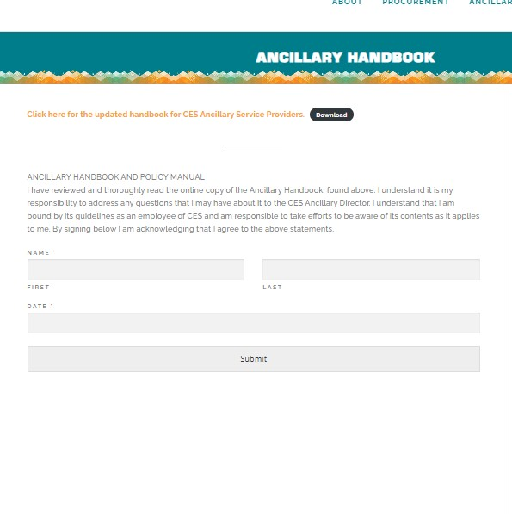
Ancillary Handbook

Slide 78
Flexible Spending Accounts
If you've signed up for a Flexible Spending Account (Health Savings Account or Dependent Care Account) please make sure you use the funds in those accounts. Receipts must be dated on or before October 31, 2021.

Slide 79
Transition from CBA to First Financial
  Upcoming virtual recording to discuss transition
  Follow up Q & A sessions will follow in September 2021
  Open enrollment in September/October

Slide 80
Insurance Premiums
NMPSIA is raising medical insurance premiums on October 1, 2021.
  6% increase on High and EPO medical plans
  3.5% increase on Low medical plans
No increase to dental or vision plans

Slide 81
Open Enrollment
We will begin open enrollment for NMPSIA and the Cafeteria plan in September. If you choose to drop NMPSIA coverage, it takes effect November 1, 2021. If you switch enrollment or add coverage, the change/add takes effect January 1, 2022.

Slide 82

For more information on PlanMember Services (Retirement and Investing) please contact Teri Thelemaque at teri@ces.org

Slide 83
Angelina Sandoval
Ancillary Administrative Assistant
Materials and
Allocations

Slide 84







Test Kits, Materials, Equipment, and Protocols
We have an extensive library of test kits, therapy materials, and protocols for you to use.

Slide 85
Follett Website – Online Library
Visit https://nmces.follettdestiny.com/ to log into your account to be able to view the materials we have available in our Ancillary Materials Library. We add to the library throughout the year! We are currently working on setting up log in credentials, we will update you as this is completed.
Your login credentials – Username: your CES email address; Password: last 4 digits of social and last 2 digits of birth year.
View what is currently checked out to you at any time.
Call or email anytime with questions!

Slide 86
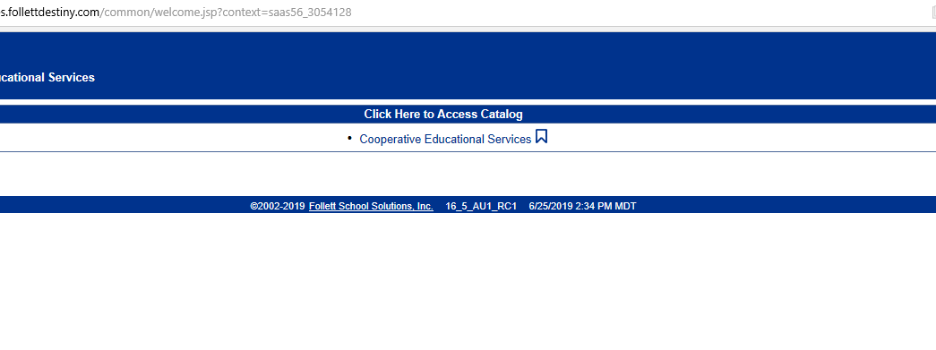
Follett Website Tour and
Account Setup
Step 1: Go to the website: https://nmces.follettdestiny.com
Step 2: Click “Cooperative Educational Services”

Slide 87
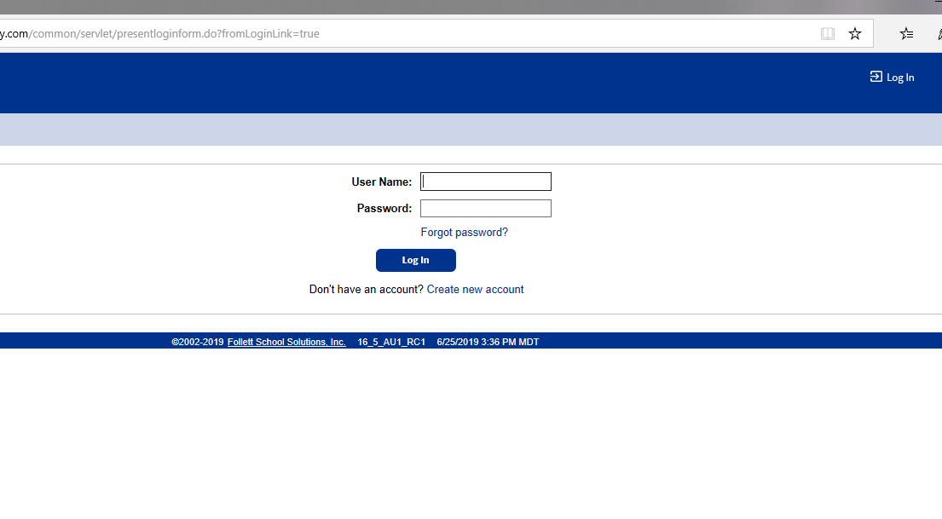
Step 3: Sign in
Username: CES email address Password: Last 4 of your Social + Last 2 of your Birth Year

Slide 88
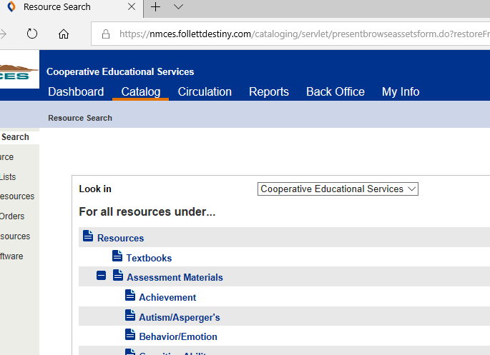
To see all the resources we have:
Click “Catalog” then click “Resources” and you will see a list of what we have.

Slide 89
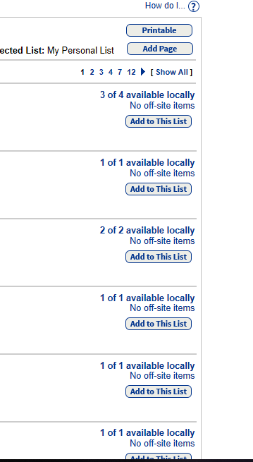
On the right side of the page, you can click “Show all” to see all resources on one page
You will also see how many we have in our library and how many are in stock.
If we don’t have an item in stock, you can still request it and I can find someone to bring it in!

Slide 90
Requesting Test Materials from CES:
ALL materials & PPE must be requested through the online request form, which can be found on the CES website. This includes test kits, online reports, paper protocols and other equipment including masks, sanitizer, face shields and gloves.
http://www.ces.org/ancillary-materials-request-form.aspx
You will receive a confirmation email stating that your materials are ready to be picked up. If a few days have lapsed, please notify me immediately.
You can also request materials we do not currently carry for purchase.

Slide 91
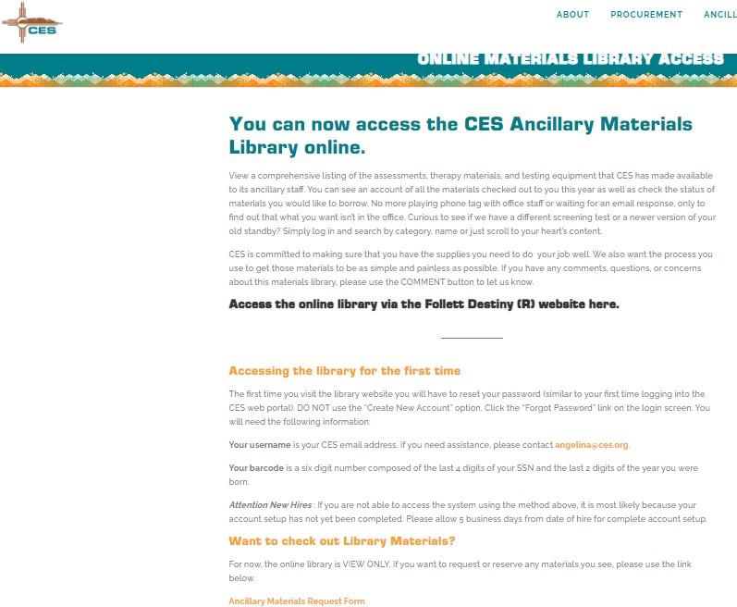
Ancillary Materials Library

Slide 92
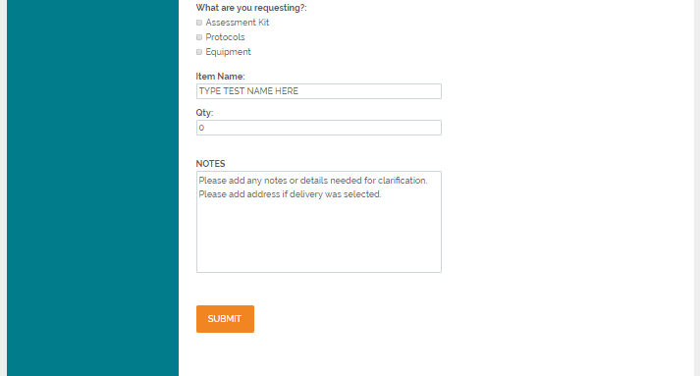
Materials Request Form
The notes section is for any other details regarding your request.
*If you chose “Home delivery” please include mailing address here.
*If you chose “Pick up by proxy” please include their name here.
*There may be a delay in processing if this information is not included.

Slide 93
Check-Out Procedures:
Browse available test kits on our library site, nmces.follettdestiny.com using your login. Find the item you are looking for and check to see if it’s available.
To request TEST KITS, PROTOCOLS, and ONLINE SCORE REPORTS, you will need to fill out and submit the request form online available at https://www.ces.org/ancillary-materials-request-form/, this is the ONLY way to request and obtain equipment from CES.
Please allow at least 2 business days for processing

Slide 94
Checking in Materials:
Dropping off materials will work a little differently for the time being (pending CDC guidelines). If you have an access card and need to drop off materials you can do so at anytime by leaving them in the back hallway at CES behind the Ancillary office. Please include a list of the materials that you are leaving and I will check them on the next business day that I am in the office. If you do not have an access card or are in outside districts, please let me know and we will make arrangements with you.
*Please note that materials are still checked out to you until they are checked for all components and checked back in. All materials that are checked out to you are your responsibility if lost, stolen, or damaged.

Slide 95
Updates
  WJ-IV Achievement scoring licenses have been issued to the CES account, scoring should be available.
  A reminder to only use the protocols and scoring licenses issued to you by CES so that we can maintain an accurate accounting of available materials.

Slide 96

WEBSITE TOUR
www.CES.org

Slide 97
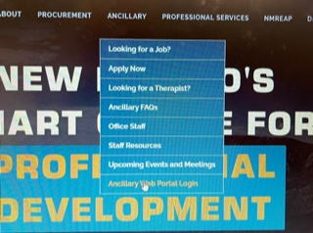

Slide 98
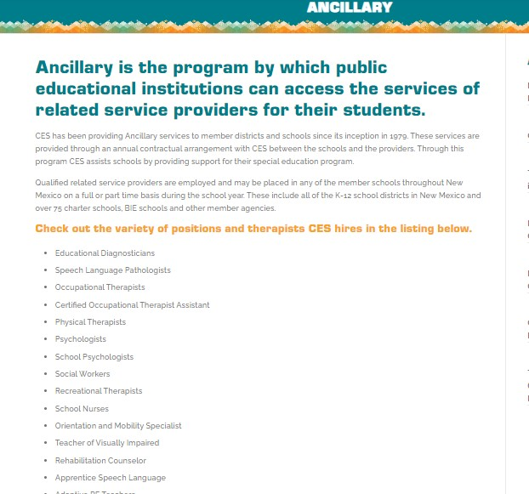
Ancillary Section

Slide 99
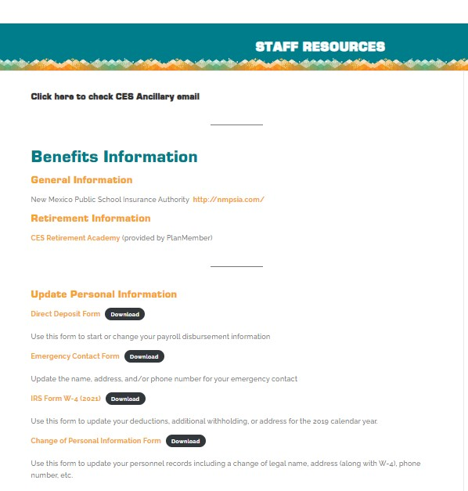
Important Info & Forms

Slide 100

CES EMAIL: our primary form of communication with you.
Check your email daily
Please only use your CES email to correspond with us, and your district/charter placements!
We Will Email You Often!

Slide 101

“Who should I email?”
Lisa– allocation questions & issues, changes in schedule, issues with district,
Angelina-Allocation updates, Updating your file, Web&Portal, scheduling with Lisa, Testing materials and protocol questions; Trainings
Mimi- Timesheets, late timesheet entries, special timesheets, CPI trainings
Teri- HR issues, benefits, workman's comp
claims, background checks
Natasha- Payroll questions/issues

Slide 102

CES TRAININGS

Slide 103
Crisis Prevention Intervention Training
Yearly Trainings (Cont.)
Certification lasts 1 year
Full Course the first year is 2 days and the
Refresher Course will be every year after for 1 day. This is
Required for everyone except School Psychologists and Diagnosticians
You must complete this ASAP – dates will be on our website under Upcoming Meetings and Events.
You may also complete this with your school and send us your Blue Certification Card.

Slide 104

Trainers
Tom House (refresher course)
Dates:
  8/14
  9/11
  10/16
  Spring courses TBD
Sara McGinnis (full course)
Dates:
  7/23 & 7/24
  9/25 & 10/2
  1/29 & 2/5

Slide 105
CPI Trainings Scheduled:
Refresher course 8/14/2021 Full Course 9/25 & 10/2/2021
Refresher course 9/11/2021 Full course 1/29 & 2/05/2022
Refresher course 10/16/2021 Full course 3/21 & 3/28/2021
Refresher course 11/06/2021
Refresher course 1/22/2022
Refresher course 2/21/2022
Refresher course 5/11 or 18, 2022
The links for these will be listed on the CES website under Ancillary>Upcoming Meeting and Events.

Slide 106
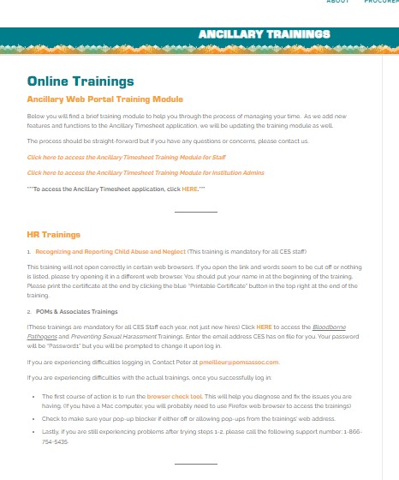
Upcoming Trainings & Meetings

Slide 107
Mimi Sacone
Ancillary Administrative Assistant
Timesheets &
CPI

Slide 108
Timesheets
Call or email Mimi with questions about:
If you have forgotten to enter your time
Timesheet adjustments
Other timesheet inquiries
Possible pay deductions resulting from disputed invoices

Slide 109
Accessing the Portal
2 ways:
  www.ces.org scroll over the “Ancillary tab” at the top and then in the dropdown box, click on “Ancillary Web Portal Login” then, using your credentials; log in OR
  Cesclient.sks.com

Slide 110
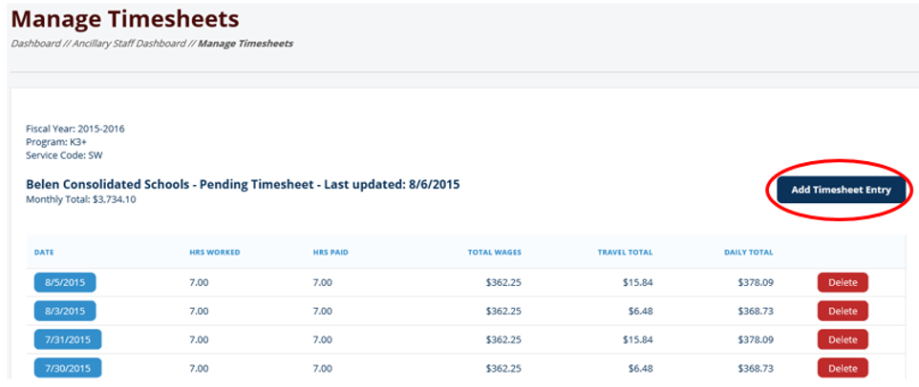
Manage Timesheets
This is where you will add timesheets. Your school administrators have access to this screen.
To add a timesheet , click ‘Add Timesheet Entry’
Notes:
To add time, click on ‘Add Timesheet Entry’

Slide 111
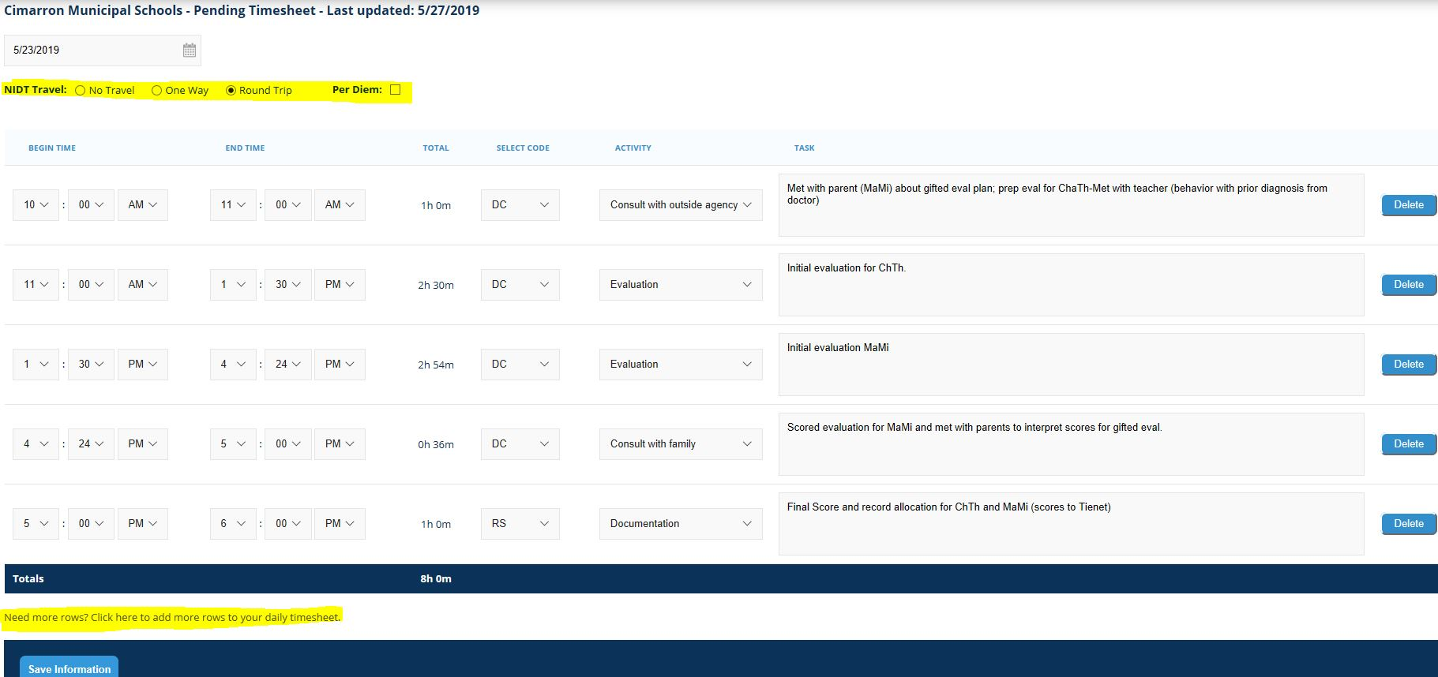
Manage Timesheet Details
Enter date
Choose NIDT Travel or Per Diem if applicable
  NIDT: Select 'No Travel', 'Round Trip', or 'One-Way’. This is for morning and evening commutes to and from school. See slide 112 for more information on NIDT.
  Per Diem: Check box. This is to be used if you will be staying in your district's city for the night.
Notes:
If your overnight is a different location than your assigned school district, please contact Lisa or Angelina in the Ancillary Office to discuss how to enter time and travel.

Slide 112
Manage Timesheet Details cont.
Enter Begin Time and End Time for each task (starts when you get to the school and when you leave the school for the day). We bill and pay in 6-minute increments. Your time should be rounded up or down to most closely match your actual time worked.
Select a Service Code (DC/RS/IDT)
  DC- Direct Contact: any face to face interactions regarding a student on your caseload. This includes phone calls with parents, meetings with other service providers and testing time.
  RS- Report/Staffing; any prep for services, paperwork, report scoring
  IDT: In “Select code” column, select IDT. A new column will appear to the right for you to input miles from school A to school B. This is for travel to different schools within your district. Do not enter a decimal point. Round up or down. Some schools do not pay this.

Slide 113
Manage Timesheet Details (cont.)
Choose an Activity from the drop down menu.
Add a task for each line item
  As simple as the initials of the child you are working with.
Click Save Information. As soon as you click Save, we have access to it and it will be pulled for payroll.
Need more rows? Click here.

Slide 114
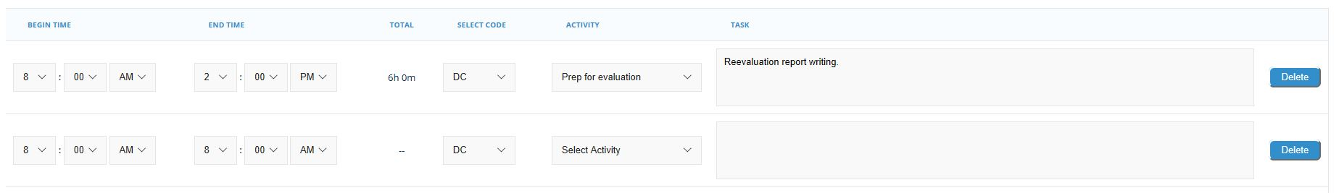
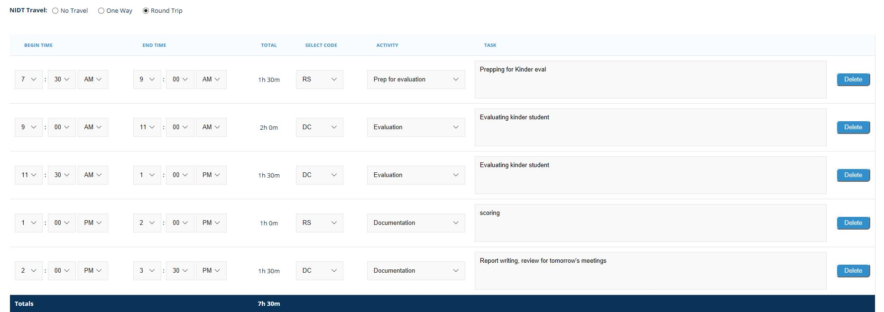
Manage Timesheet Details (cont.)
Bad example- too vague
Good example- broken out between tasks> SCHOOLS and DISTRICTS WANT STUDENT INITIALS WITH EVERY TASK ENTERED.

Slide 115
Travel Information
    IDT – Intra-District Travel; traveling between different schools within the same district
      IDT is not given automatically. If you need, but do not have the option of billing IDT, please ask your site administrator so that it be turned on for you.
      You must bill your mileage as a WHOLE NUMBER and should consistently bill the same distance between locations.
    NIDT – NON-Intra-District Travel; travel from home to school and school to home.
      This is only added for schools outside of Albuquerque when you live in a different town than the town your school is in. If you live in the town you are working at, you do not receive NIDT.
      You are paid ½ of your hourly rate for your morning and evening commutes plus $0.36/mile.
      This amount is preset for you. It is billed from city center to city center and should represent the AVERAGE distance between locations. If you move to a different city during the school year, please ask our office to recalculate your NIDT.

Slide 116
Timesheet Errors
Reasons your timesheet might not save:
  If nothing is entered in the task box your timesheet will not save.
  If there is a space before your first word in the task box it will give you an error message saying, “task cannot be left blank”. Put the cursor before the first word in every box and press delete to see if you have a space.
  If AM and PM are not changed accordingly, your timesheet will not save. (look at the total hours at the bottom, if it’s negative, look at your AM’s and PM’s.)
  If there is a decimal point when IDT miles are entered, clicking the save button will delete your entire timesheet and you will have to start over.
  *If you work at 2 different school districts on the same day* Time cannot be entered within the same time frame on 2 different timesheets for the same day, an error will occur saying that you cannot overlap time.

Slide 117

Time Sheets
We will bill exactly what you put on your time sheet. This means you should NOT include any unbillable time (lunch or breaks, snow days, time entering your time sheets, etc.)
  *A failed attempt to deliver services that includes travel time should be entered in the web portal with an explanatory note.

Slide 118

Time Sheets
YOU MUST enter your timesheets WEEKLY. Please keep up with them!
The more often you log your time, the less time entering them will take and the task descriptions will be more accurate.

Slide 119
Timesheet Due Dates
Timesheets are due twice per month at 11:59pm:
  Timesheets for the 1st – 15th are due on the 15th of the month BY 11:59 PM
  Timesheets for the 16th – last day of the month are due on the last day of the month BY 11:59 PM
If you miss the due date:
  Email the person at your school/district who approves your timesheets to let them know.
  CC Lisa & Mimi on email
  Know that payment of your time may be delayed

Slide 120
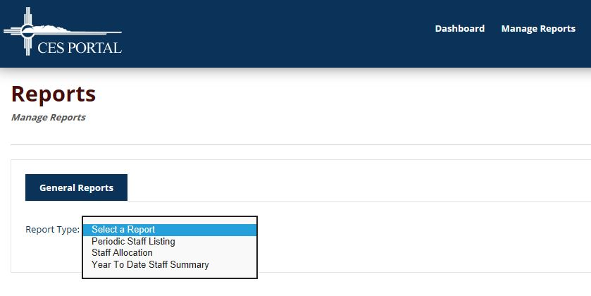
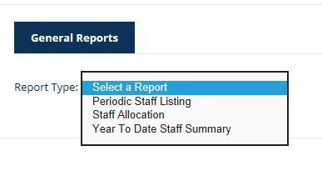
Useful Reports
Click “manage reports” in the upper right hand corner.
Select a report:
  Periodic Staff Listing will show you what has been invoiced and sent to payroll and what has not.
  Staff Allocation shows you what has been allocated for each school.
  Year to Date Staff Summary will show you all the time you have entered, how many total hours you had on your allocation and how many you have remaining at any given time.

Slide 121
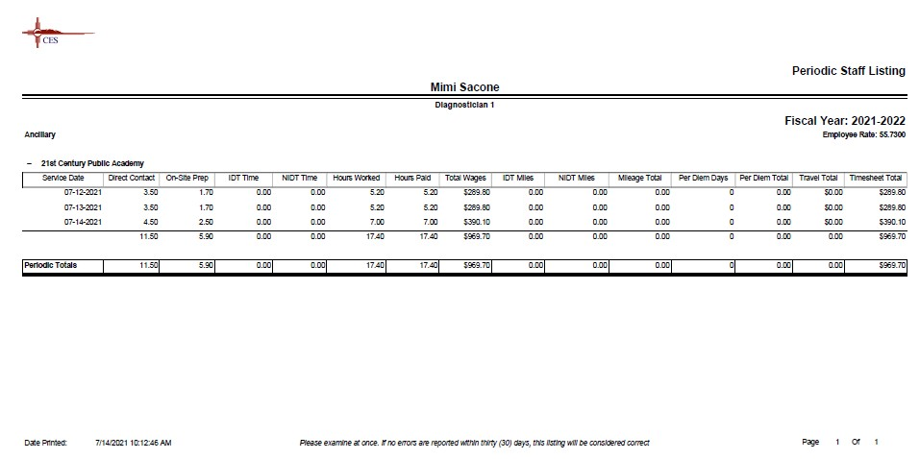
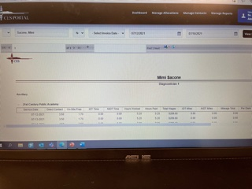
Periodic Staff Listing Report Sample

Slide 122
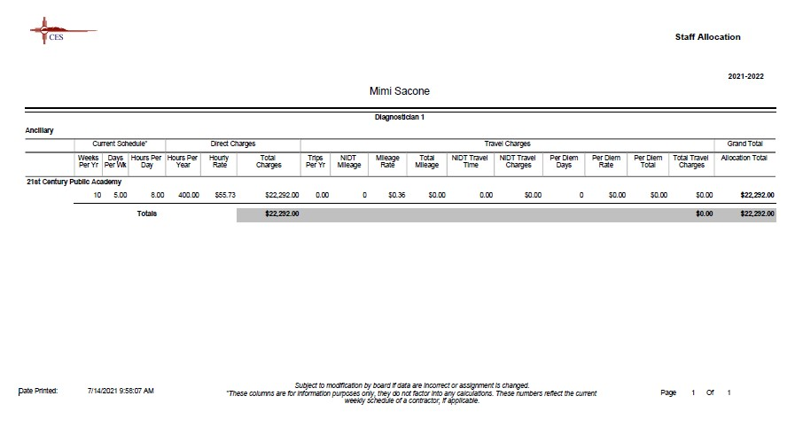
Staff Allocation Report Example

Slide 123
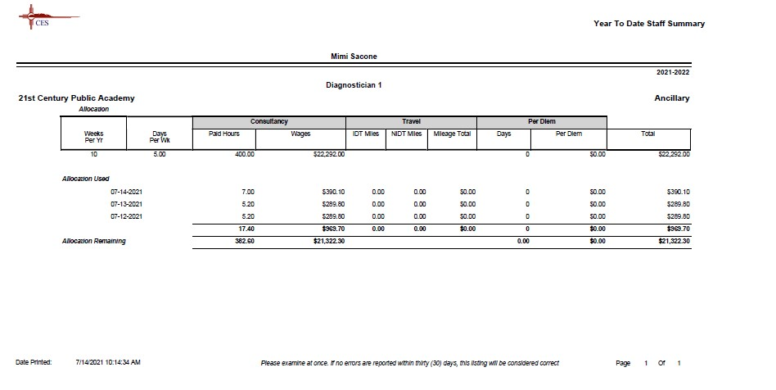
Year To Date Staff Summary Report Sample

Slide 124
Log Out
To Log Out, go to the upper right corner, click on down arrow next to your name and choose ‘Log Out’

Slide 125
Training Module
Go to https://www.ces.org/ancillary-trainings/
Choose the appropriate tutorial, there is one for staff and one for district institution admins.

Slide 126
Districts with Special Invoicing Instructions or Expectations-
Things to be aware of:
Albuquerque Public Schools— Contractor Log
Espanola Public Schools— Billing by Location Worksheet
Santa Fe Public Schools—Contractor Log, Leave Slip

Slide 127
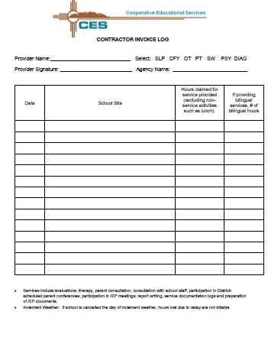
Albuquerque Public Schools—
Contractor Log Example

Slide 128
Espanola Public Schools— Billing by Location Worksheet Sample
Española Public Schools
Ancillary Billing By Location
Provider Name: | Mimi Sacone
Date From: | 5/1/2021 | Date To: | 5/31/2021
Location | Rate | Total # Hours | Sub-Total (hours @ location) | NIDT Travel | Mileage | Travel time & Mileage Subtotal | Grand Total
ABIQUIU (005) | $ 55.73 |  | $ - |  |  | $ - | $ -
ALCALDE (015) | $ 55.73 | 1 | $ 55.73 |  |  | $ - | $ 55.73
CFVMS (019) | $ 55.73 | 11 | $ 613.03 |  |  | $ - | $ 613.03
CHIMAYO (039) | $ 55.73 | 8.2 | $ 456.99 | $ 35.05 | $ 18.72 | $ 53.77 | $ 510.756
DIXON (042) | $ 55.73 |  | $ - |  |  | $ - | $ -
ETS (053) | $ 55.73 | 9.5 | $ 529.44 | $ 35.05 | $ 18.72 | $ 53.77 | $ 583.21
EVHS (050) | $ 55.73 | 16.7 | $ 930.69 | $ 140.14 | $ 74.88 | $ 215.02 | $ 1,145.71
HERNANDEZ (008) | $ 55.73 |  | $ - |  |  | $ - | $ -
HOMEBOUND | $ 55.73 | 1.8 | $ 100.31 |  |  | $ - | $ 100.31
JHR (048) | $ 55.73 | 3 | $ 167.19 |  |  | $ - | $ 167.19
LNKC (142) | $ 55.73 |  | $ - |  |  | $ - | $ -
MISC. PRIVATE (188) | $ 55.73 |  | $ - |  |  | $ - | $ -
SAN JUAN (144) | $ 55.73 | 14.2 | $ 791.37 |  |  | $ - | $ 791.37
TEQ (145) | $ 55.73 |  | $ - |  |  | $ - | $ -
VELARDE (169) | $ 55.73 |  | $ - |  |  | $ - | $ -
TOTAL AMOUNT DUE | $ 55.73 | 65.4 | $ 3,644.74 | 210.24 | $ 112.32 | $ 322.56 | $ 3,967.30
 |  |  |  |  |  |  | $ 3,967.30

Slide 129
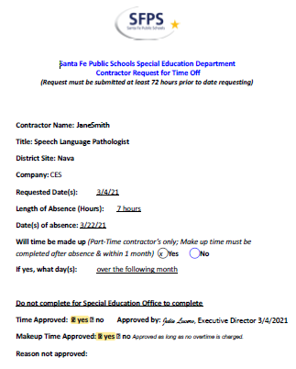
Santa Fe Public Schools—
Contractor Log Sample
Leave Slip Sample

Slide 130
Your To-Do List
Make sure you have submitted any requested documents to Teri in HR.
Sign up for CPI. Contact Angelina for details.
Browse our Library Inventory online, look around, before school starts.
Yearly Trainings

Slide 131
Brad Schroeder,
Information Technology Manager
IT

Slide 132
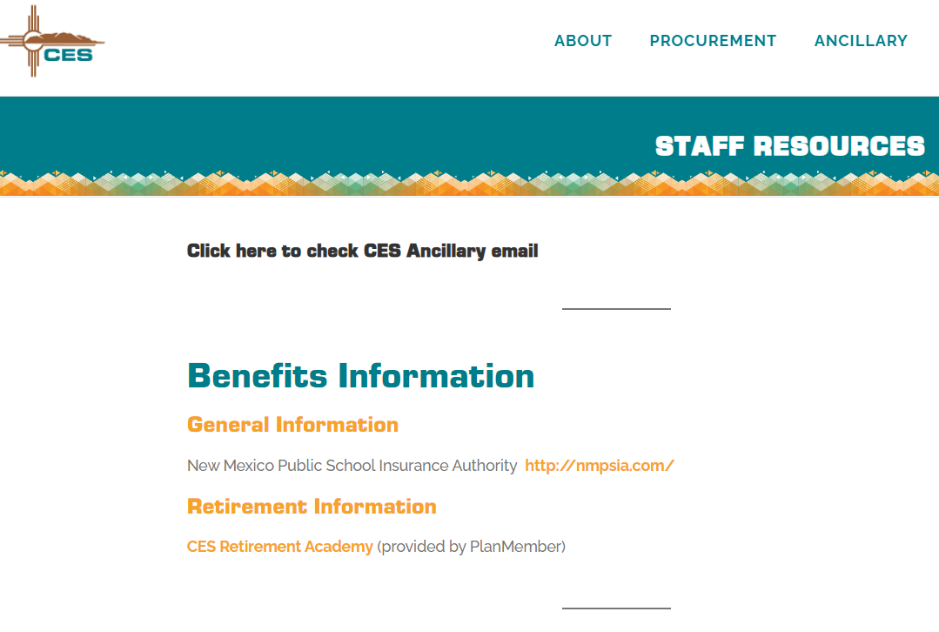
Accessing Email on CES Website
Direct:
http://mail.ces.org
Notes:
Removed from the Home Page of the website to mitigate the likelihood of hacks, spam, phishing, etc.
Brad insert direct link

Slide 133

Building Access During Business Hours:
Ancillary staff must enter the building using main doors during business hours.
You must adhere to current requirements issued by NM Department of Health at the time.
Access cards will be distributed as needed.

Slide 134

Building Access after Business Hours:
Ancillary staff will have access to the Ancillary exterior door (after business hours) using your access key.
You will be issued access cards depending on your site location.
Please enter the building from the Southwest Ancillary doors

Slide 135
Requests for Equipment
CES Ancillary Handbook
  Section K Equipment and Supplies (page 8)
    “The ancillary staff member will provide personal office equipment and materials.”
  Section V Technology Acceptable Use (pages 10-11)
Notes:
Generally speaking, it is the responsibility of the CES Ancillary Employee to equip themselves with the office equipment they need to do their jobs: lap tops, printers, paper, etc.
However, CES did recognize the need to support staff during the pandemic, by purchasing a small # of technology and equipment:
Dual monitors
Document cameras
Head sets

Slide 136
Requests for Laptops
Ancillary Handbook states
“CES will supplement equipment and materials for student treatment and evaluation as available.”
Ancillary Handbook further states
“The ancillary staff member accepts responsibility for materials checked out to them from CES and must pay for or replace any lost or stolen items checked out to them.”
Notes:
At this point, Ancillary Handbook does not indicate that CES employees are responsible for damaged equipment, however, this will provision will eventually be added to the handbook.
While CES did take on more of a role in furnishing equipment that would have otherwise been the responsibility of the employee (during the pandemic), the expectation going forward is that CES Ancillary Staff will furnish their own equipment.
CES does have a limited supply of laptops that may be issued to ancillary staff. However, we ask that you return the lap top in the condition that you received it. Keys on keyboard, functioning screen, etc.

Slide 137
Lisa Chacon-Kedge
Director of
Ancillary Services
Final
Comments

Slide 138
Have a great school year!
Please email Ancillary Office staff with any changes that need to be made to allocations.
lisa@ces.org
angelina@ces.org
mimi@ces.org
ALLOCATION CHANGES OR QUESTIONS
UPDATED LICENSES, AUTO INSURANCE, etc.

