Slide 1

New Mexico Documentation for Therapy/Evaluations
The information is not intended to be legal advice.
Based on Best Practice Information
http://www.asha.org/SLP/Documentation-in-Schools-FAQs
Cooperative Educational Services
Kelley McMillen, MACCC-SLP
kelleykoh@msn.com

Slide 2

Table of Contents
Pg. 3 Documentation- What is required?
http://www.asha.org/SLP/Assessment-and-Evaluation-of-Speech-Language-Disorders-in-Schools/
Pg. 4 Documentation to avoid.
Pg. 5 Referrals
Pg. 6 Screenings
Screening K-1 Speech-Language.doc
Screening 2-5 Speech-Language.doc
General Speech Screening form.doc
Pg. 7-13 Initial Evaluations
Male Initial eval articulation.doc
Female Initial eval articulation.doc
http://www.home-speech-home.com/speech-therapy-test-descriptions.html
Pg. 14 NM PED Report Requirements
NMTeamManual.pdf
NM Guidelines Speech.pdf
Pg. 15-16 Review Existing Evaluation Data (REED)
2014 Consent for Evaluation REED reeval.docx
MD- REED EDT-PWN 2014.docx
OHI- REED EDT-PWN 2014.docx
TBI- REED EDT-PWN 2014.docx
SLD - REED EDT-PWN 2014.docx
SLI - REED EDT-PWN 2014.docx
Pg. 17 Reevaluations
Male Reeval SLP Speech Language.doc
Female Reeval SLP Speech Language.doc
Pg. 18-20 Eligibility Determination Team (EDT)
Autism - EDT-PWN 2014.docx
Deaf-Blindness - EDT-PWN 2014.docx
Developmentally Delayed - REED EDT-PPWN 2014.docx
Hearing Impairment- REED EDT-PWN 2014.docx
Intellectual Disability- REED EDT-PWN 2014.docx
Pg. 21 Individualized Educational Program (IEP)
Pg. 22-26 Goals and Objectives (sample flowchart)
common core extended SPED Lang.pdf
Common Core extended SPED math.pdf
SLPGoalsandObjectivesupdate.pdf
Pg. 27-30 Required documentation
Pg. 31-34 Documentation Efficiency
SOAP notes Excel template.xlsx
Weekly Therapy Breakdown Template Sample.xlsx
Pg. 35 Sample Forms for Notes
Medicaid Tx Log.doc
Medicaid Tx Log 2.doc
THERAPY LOG.doc
THERAPY LOG Base10.doc
Therapy Log11.doc
Pg. 36 Sample Database
CES Training 2015\Final MASTER Ancillary Database.mdb

Slide 3

Documentation- What is required?
It is important to have the right balance when it comes to documentation. Too much and too little can be a problem.
http://www.asha.org/SLP/Assessment-and-Evaluation-of-Speech-Language-Disorders-in-Schools/
What to document:
Referrals (Screening/Evaluations/Permission to test)
ANY contact with parents/teachers/students
SOAP note for therapy sessions
ANY trainings

Slide 4

What documentation should I avoid?
Avoid excessive emails
Avoid documenting personal stories in notes
Avoid texting information regarding students
Avoid any documentation beyond the IEP goals and objectives
WHY???
E-mail is considered part of the student record if it is placed in the student record. E-mail, text messages, and other electronic communications can be subpoenaed regardless of whether they are part of the student record. Fax confirmations and postal receipts would be considered appropriate to be included in the student file. All content with personally identifiable information (PII) is considered part of the student record, so if the student's name is in the e-mail, it is assumed to be part of FERPA. Be judicious with e-mail and limit information shared regarding students. (ASHA.org)
This type of documentation MAY be needed when dealing with
a mediated agreement or Due Process situation. This assures
clarity and decreases miscommunication.

Slide 5

REFERRALS
*Screenings
*Initial evaluations
*REEDs
*Reevaluations

Slide 6

Screenings
Do I need permission?
It is HIGHLY debated, so YES! It is better to be safe and offer full disclosure to the parent before any screening occurs.
Basic permission form: CES Training 2015\Parent Permission to Screen Speech Language.doc

Slide 7

Initial Evaluations…(refer if not qualified)
  Initial referral based on school procedure
  * SAT (Student Assistance Team)
  * Diagnostician
  * Mediated Agreement/Due Process Hearing
  * Parent request
  PARENT PERMISSION (keep a copy)!!
  Hearing screening
  Vision screening
  Case History
  Interviews with concerned parties
  Formal/Informal testing, as appropriate
***Evaluations can take place over multiple sessions,
However, you can only bill the initial session to Medicaid.
The additional sessions you would document as “Other”.

Slide 8

Initial Evaluation is completed… now what?
After the testing is completed, determine if there are any referrals that might need to be considered. Follow school district procedures.
Prepare report
CES Training 2015\Initial template speech artic voice fluency.doc
Wait for Eligibility Determination Team meeting (EDT)
***For efficiency, most therapists create template reports of the tests they generally use with all essential information. By using the word “student” in place of a name, it is easy to REPLACE the name in the document. You can add and remove information based on the tests given. Make sure you
create one for males and one for females.

Slide 9

Do they qualify?
For initial evaluations, it is important to follow PED guidelines for qualifying a student for services.
Speech or Language Impairment- A speech or language impairment means a communication disorder, such as stuttering, impaired articulation, a language impairment, or a voice impairment that adversely affects a child's educational performance. (34 CFR Sec. 300.8(c)(11))
Eligibility- Children who are eligible for special education and related services under the category of speech or language impairment (SLI) have a disability that adversely affects their involvement and progress in the general curriculum, including extracurricular and non-academic activities, or their participation in developmentally appropriate activities. To identify characteristics and educational impact, the EDT must address the question of “How do these characteristics of the disability manifest in the child’s natural environment (e.g., home, classroom, recess, etc.)?”

Slide 10
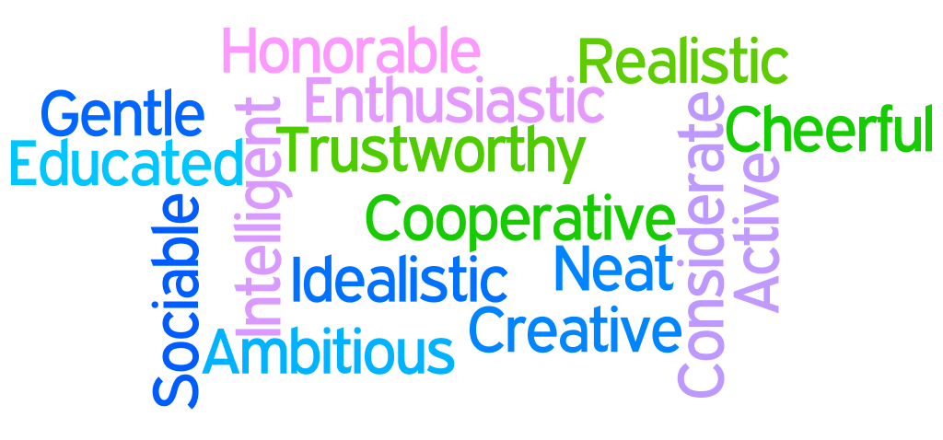
Preschool
Preschool-aged Children. For preschool-aged children with SLI, it is important to consider developmentally appropriate skill levels and behaviors for the child’s age, since they are not necessarily involved in the general education curriculum. For preschool-aged children with SLI, the observed characteristics are very similar (although not identical) to those demonstrated by school-aged children with SLI. These difficulties may impact the child in one or more of the following ways:
Speech
o Deficits with speech production, including difficulty: o Correctly articulating sounds and words;
o Formulating words, phrases, and/or sentences; and/or
o Speaking clearly enough to get basic wants and needs met.
Language
o Deficits with expressive language skills, including difficulty: o Expressing wants, needs, and/or feelings;
o Retelling stories and experiences;
o Sharing information; and/or
o Using age-appropriate vocabulary.
o Deficits with receptive language, including difficulty: o Following basic directions;
o Understanding what peers and adults are saying;
o Learning and understanding age-appropriate vocabulary; and/or
o Learning age-appropriate concepts, such as positions, sizes, etc.
o Deficits with phonological skills, including difficulty: o Learning nursery rhymes;
o Discriminating between sounds; and/or
o Acquiring pre-reading skills.

Slide 11

School Age
School-aged Children. For school-aged children with SLI, the impact of the disability may be manifested in one or more of the following ways:
Speech
o Deficits with speech production, which may lead to difficulty with or reluctance in: o Correctly articulating sounds and words;
o Participating in class discussions and oral presentations; and/or
o Participating in social activities.
Language
o Deficits understanding language, including difficulty: o Understanding classroom discussions and instruction (auditory comprehension);
o Understanding age-appropriate vocabulary;
o Learning and understanding new curriculum-based vocabulary;
o Recognizing rules regarding interpersonal skills; and/or
o Acquiring the skills required for early reading success.
o Deficits generating language, including difficulty: o Formulating grammatically-correct sentences;
o Explaining and describing people, places, events, etc.; and/or
o Using age-appropriate vocabulary.
o Deficits with the social use of language, including difficulty: o Interacting appropriately with peers and adults;
o Taking turns in conversation;
o Responding to verbal and nonverbal cues from others; and/or
o Repairing communication break-downs.

Slide 12

Speech Impairment vs English Second Language (ESL)
Special Considerations for Assessment. A speech or language impairment is to be differentiated from a speech or language difference which may be due to bilingualism, dialectical or cultural differences in language use, or being non-English dominant. A communication difference/dialect is a variation of a communication system used by a group of individuals that reflects and is determined by shared regional, social, or cultural/ethnic factors and should not be considered a disorder of speech or language.
***They MUST have the deficit in native language.

Slide 13

Eligibility determination: SLI
Eligibility Determination. For BOTH speech and language disorders, for a child to be eligible to receive special education and related services under the eligibility category of SLI, as defined by IDEA (2004), the EDT must document that the child meets all of the following eligibility criteria:
1. The EDT has eliminated the possibility that lack of appropriate instruction in reading or math is a determinant factor. For preschool children, consider whether the child has had the opportunity to participate in developmentally appropriate early childhood experiences.
2. The EDT has eliminated the possibility that limited English proficiency is a determinant factor.
3. The EDT has determined that no other eligibility category (for example, specific learning disability in the area of oral expression/listening comprehension, autism, or intellectual disability) better describes the child’s disability.
4. The child has a speech or language impairment and is not merely exhibiting a language difference.
5. A pattern of assessment data, including both formal and informal measures, support the
eligibility under the category of SLI.
a. Standard scores yielded by formal assessments must be statistically significant, i.e., more than 2
standard deviations below the mean considering SEM (standard error of measure).
b. When the results of formal and informal measures are discrepant, a weight of evidence from
multiple descriptive measures must support the existence of a speech or language impairment.
CES Training 2015\Score Conversion Chart.pdf
In addition, the EDT must document that the child demonstrates a need for special education and related services because, as a result of the disability, the child requires specially designed instruction in order to: (a) be involved in and make progress in the general education curriculum; (b) participate in extracurricular and other nonacademic activities; and/or (c) be educated and participate with other children with disabilities and nondisabled children.

Slide 14

NM PED Speech Report Requirements
Review of existing data, background, concerns.
Gather and analyze developmental/educational, medical, family, and social history. (Case history)
Conduct functional communication assessment.
Intelligibility statement.
Complete spontaneous speech sample, include concerns.
Conduct oral/mechanism/oral motor exam.
Conduct transition assessment (as indicated)
Use standardized or alternative methods (e.g., informal, criterion referenced) to obtain data about child’s present levels of performance.
Articulation statement. Stimulability statement, if errors occur.
Speech sound inventory if speech sound errors occur.
Voice statement (quality, resonance, pitch, volume)
Fluency statement (oral, laryngeal, respiratory behaviors)
Hearing/Vision statement.
(Language include additional)
*Standardized/non-standardized assessments (receptive, expressive, semantics, syntax, pragmatics)
*cognitive abilities statement, as appropriate.
14. Summary/Recommendation statement: Include statement if student qualifies for services.

Slide 15

Review Existing Evaluation Data (REED) in place of formal 3 year reevaluation?
A review of existing evaluation data (REED) is the process of looking at the student’s existing data to determine if additional data are needed as part of the evaluation process. If the team can determine the student continues to have a disability, no formal evaluation is required.
Whether the student has or continues to have a disability.
Whether the student’s present levels of academic achievement needs and related developmental needs have changed.
Whether the student needs or continues to need special education and related services.
Whether the student needs any additions or modifications to the program to participate in the general education curriculum.
***Formal testing may be required in specific areas.

Slide 16

Therapist Requirements at REED.
The therapist is required to complete the section on the REED form that pertains to the area they address.
Mark ancillary area
Data source/Date
Detailed description of information and Present Levels
Sign REED form (if present)
If additional testing is needed, you MUST mark on the form below that formal testing is required.

Slide 17

Reevaluations
  PARENT PERMISSION (keep a copy)!!
  Hearing screening
  Vision screening
  Interviews with concerned parties
  Formal/Informal testing, as appropriate
http://www.home-speech-home.com/speech-therapy-test-descriptions.html
Prepare report (prepare template reports for male and female)
Wait for Eligibility Determination Team meeting
(EDT)

Slide 18

Eligibility Determination Team (EDT)
Each eligibility criteria includes a detailed list of criteria that a child MUST meet in order to demonstrate that he/she has a disability as defined by IDEA (2004). In addition, the EDT must document that the child demonstrates a need for special education and related services because, as a result of the disability, the child requires specially designed instruction in order to: (a) be involved in and make progress in general education curriculum (or for preschool, to participate in activities); (b) participate in extracurricular and other nonacademic activities; and/or (c.) be educated and participate with other children with disabilities and nondisabled children.
http://www.ped.state.nm.us/SEB/technical/NMTeamManual.pdf

Slide 19

EDT Meeting…
The EDT meeting will determine the BEST eligibility that explains the students area of difficulty. Some districts allow two eligibilities, others do not.
AU- Autism
Deaf-Blindness
DD- Developmental Delay (age 9)
ED- Emotional Disturbance
HI- Hearing Impairment
ID- Intellectual Disability
MD- Multiple Disabilities
OI- Orthopedic Impairment
OHI- Other Health Impairment
SLD- Specific Learning Disabled
SLI- Speech-Language Impaired
TBI- Traumatic Brain Injury
VI- Visual Impairment

Slide 20

Therapist Requirements at EDT.
Give Present Levels of Performance (PLP)
Determine continued eligiblity statement of therapy based on REED or Reevaluation.
Determine student SPED eligibility as a team
Sign EDT form (if present)
IEP meeting might occur here…

Slide 21
Individualized Educational Program (IEP) document
Due to scheduling difficulties, it is VITAL to ensure the current information for your therapy is included within the document. If for some reason it is not included, request an addendum to add the information needed. It is the responsibility of the therapist to ensure
the information is included.
REQUIREMENTS:
Attend the IEP meeting (unless parent agrees to your absence)
Report evaluation findings (copy of report to file and parent)
Provide Present Levels of Performance (PLP) addressing goals
Provide measurable goals/objectives based on documented
areas of concern.
Provide service level (based on district standards)
(*45 min/wk, 1.0 hr/wk min 28 wks, 2.0 hr/mo, 1800 min/yr)
Sign signature page, if PRESENT at the meeting (in person, phone)

Slide 22
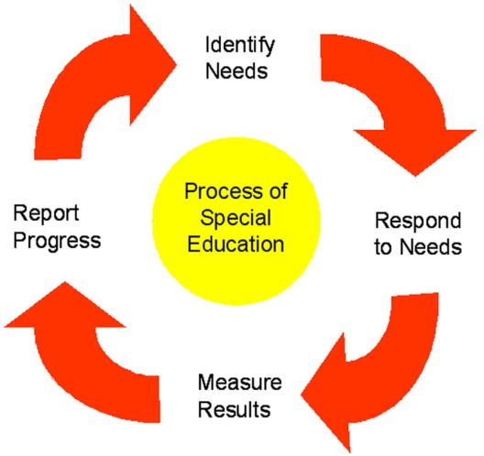
Goals and Objectives
NM follows Common Core Standards

Slide 23

Common Core: Speech
Use the Standards: The CCSS can be used when developing Individualized Education Plan (IEP) goals and objectives. The CCSS cover all grades from K-12. As mandated by the Individuals with Disabilities Education Act (IDEA), students with disabilities need to have access to and must be challenged to succeed in the general education curriculum.² The IEP goals should be aligned with the grade-level academic standards, which are now the CCSS.
Breaking Down the Standards: SLPs will find that many of the English/Language Arts standards link directly to what the school SLP already targets with caseload and Response to Intervention (RTI) students. They include key terminology the SLP uses on a daily basis when writing IEP goals/objectives, collaborating with teachers and reporting progress to parents.
Example 1: Speaking and Listening Standard K-5: Describe people, places, things and events with relevant details, expressing ideas and feelings clearly (1st grade).
This standard ties in to the SLP's work on expressive language and improving the use of adjectives. The element of relevance also links to the common work of discussing what an important detail is versus a minor detail.
Example 2: Reading Standards for Literature K-5: Ask and answer such questions as who, what, where, when, why and how to demonstrate understanding of key details in a text (2nd grade).
SLPs frequently work on WH question forms and helping students understand who, what, where, when, and why, but also to gain the skills to be able to respond appropriately to such question forms.
Example 3: Reading Standards for Literature K-5: Determine the meaning of words and phrases as they are used in a text, distinguishing literal from non-literal language (3rd grade).
The CCSS provide a direct link to using classroom text for vocabulary intervention and includes the element of literal and non-literal language concepts, which many students who have language impairments struggle with.
http://speech-language-pathology-audiology.advanceweb.com/Features/Articles/Common-Core-State-Standards.aspx

Slide 24

Measurable Goals/Objectives
Many districts are moving to a computerized IEP format that will not allow goals to be added unless they are measurable. It’s important to make goals “readable” to any team member that might read the goal.
Annual Goal: Goal that can “reasonably” be met with an IEP year.
Objective: Short term breakdown of steps to reach annual goal.
[REQUIRED: for Alternative Assessment Students]
**Skills students will actually use in their real life.
**Skills required in order to acquire other useful skills.
**Skills the teacher wants students to use in classroom.
**Skills the students want to use in their real life.

Slide 25
Measurable goals/objectives flowchart
PERFORMANCE
CLEAR OBSERVABLE
ACTION
ANNUAL
TIMEFRAME
STUDENT NAME
CONDITIONS
(how/what
available)
CRITERION
(Speed/ %
Days/Cues)
Within one year
By ____________
VERBAL:
will state will tell
will list will name
will recite will read
will define will decode
INTELLECTUAL SKILLS
will identify
will label
will sort category items
will classify
will categorize
will solve
will show
will demonstrate
will develop
will create
will calculate
will predict
will define
MOTOR
will write
will climb
will balance
will trace
will type
will drill
will assemble
will imitate
ARTIC:
Initial ___ in isolation
Medial ___ in words
Final ___ in sentences
Target sound in connected speech
LANGUAGE:
Words
Paragraph
Vocabulary term
Definition
Sight words
Objects
WH question
Classwork
Story
MOTOR
Within lines
Letters
Words
Stairs
Objects
Puzzles
Classwork
Physical activity
GIVEN????????????????
Story, tools, graphs, model, picture, notes, paragraph
w/ ___ % accuracy.
w/ ___% acc over 3 consec sess.
w/ ___% acc and 2 verbal cues.
w/ ___% acc and 2 repetitions.
w/ ___% acc in all environments.
w/ ___% acc with no cues.
w/ ___% acc with no repetitions.
7 out of 10 opportunities
over 5 consec sess.
100% acc with no cues.
90% acc with no more 4 cues.
no more 2 cues per TX session.
in 5 minutes with 2 errors/less
with maximum assistance.
with hand-over-hand support.
10 times a day with 2 cues.
This list is Not complete
And should be used as
A guideline for
Writing measurable
Goals.
MEASURE
Skilled observation/documentation
Pre/Post Data Skill check
Other: ____________________

Slide 26

Three components of effective goal/objective.
1. Performance
  -description of behavior learner is expected to perform
  -measurable and/or observable
  -describe what learner will be demonstrating for mastery
2. Conditions
-description of the circumstances performance will be carried out
-what will be available (GIVEN) when they perform the behavior
3. Criterion
-description for acceptance of performance as sufficient/mastery
-how well must the activity be done?
-how well to be considered “competent” in this area?
-this could be based on speed, accuracy, support needed, consistency

Slide 27
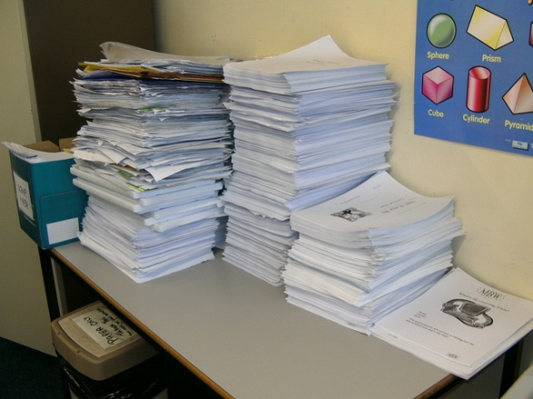
Documentation
Audit Ready
Medicaid Ready
Working File vs. Central File
SOAP notes

Slide 28

Audit Requirements
An audit is generally performed as a check to determine if a file has all required components. The district is responsible for maintaining the central file. The therapist is responsible for providing the components to complete their paperwork to completion.
Screenings/initial evaluations/Reevaluations/Exit Reports
IEP present levels of performance (PLP)
IEP measurable goals/objectives
Cumulative Progress reports based on IEP
Calendar of therapy sessions/times (Maxcapture)
Notes from each contact with student/team (Maxcapture)
Copy of trainings and signature pages
Extended School Year (ESY) regression form (as needed)
Medicaid Billing

Slide 29

Medicaid Ready…
Medicaid billing is an important part of therapy services for the school reimbursement. It is important to complete makeup sessions within 120 days of missed session.
**You MAY NOT bill ahead
**You may bill for documented MAKEUP sessions
11/5/14 MAKEUP SESSION DUE
12/8/14 MAKEUP SESSION for 11/5/14.
**Do not overbill. Most schools have a block so this
cannot occur.
**Use SOAP note when documenting Medicaid billing to
reduce paperwork.
**Make a copy of the Medicaid at the end of the year for
your documentation.
**Document ALL contact with students/team, if possible.
*Other- phone calls, paperwork
*Consult- training team members
*Collaboration- team meetings

Slide 30
Working File vs. Central File
Working files are for the current therapist. Generally, any working files that are sent to the next school contain goals and a progress report. DO NOT SEND your notes of therapy or your treatment calendar.
Central files are for the required paperwork for Medicaid and the state. Districts have different policies for paperwork. Check each district with regards to protocols, end of the year checkout, and filing your reports. Follow the procedures at each district and complete the specific forms required.

Slide 31
Documentation Efficiency
Work SMARTER… not harder!

Slide 32
Templates
Boy Screening template
Girl Screening template
Boy Initial evaluation template
Girl Initial evaluation template
Boy Reevaluation template (can be exit report)
Girl Reevaluation template (can be exit report)
Cumulative Progress Report template
-end of year summary statement
-transition recommendation statement
-Extended School Year (ESY) statement
-compensatory time statement

Slide 33

SOAP Notes
To decrease the amount of overall paperwork, it is effective to complete a SOAP note for each therapy session. If time permits, putting the SOAP note directly into Maxcapture will eliminate an additional note in the working file.
If time is not on your side, you can use a general form to document the most important information for Maxcapture entry. Each therapist is different. The goal of documentation is to look at it years later and be able to explain what the session was covering and how the student did.
S: (Subjective)
O: (Objective of session)
A: (Assessment of student at session)
P: (Plan of action for next session)

Slide 34
Maxcapture & SOAP note (example)
Goal: Expressive language, receptive language
S: no behaviors, arrived independently
O: OUTBURST, problem solving, vocabulary, peer interactions, turn taking, categories
A: Johnny required additional time and over 5 cues per turn. He did well with cues and answered over 50% of the items. Turn taking required minimal reminders. Peer interactions were good.
P: Continue this activity and goal.

Slide 35
Sample Note Forms
Medicaid Tx Log.doc
Medicaid Tx Log 2.doc
THERAPY LOG.doc
THERAPY LOG Base10.doc
Therapy Log11.doc

